Slide 1



PRESENTED BY :-
ASHWITHA RAI
RAHUL KUMAR
RAKSHITH KARUMBAIAH
SAHANA HEGDE
SUPRITA VENKAT G V
Notes:
Photos by Freepik

Slide 2

OBJECTIVE
Full Stack Developer by gaining all the skills required to work with front end and back end web technologies.
Confident in all the concepts and
become a successful product engineer

Slide 3
WHERE DO WE STAND ?
HTML
CSS
BOOTSTRAP
ANGULAR 7
SPRING BOOT
JSP
MAVEN
TOMCAT
DBMS
CORE JAVA
JENKINS
MYBATIS
Knowledge

Slide 4
PROBLEM STATEMENT
To develop an interactive Ecommerce Application where
one can perform Online shopping

Slide 5
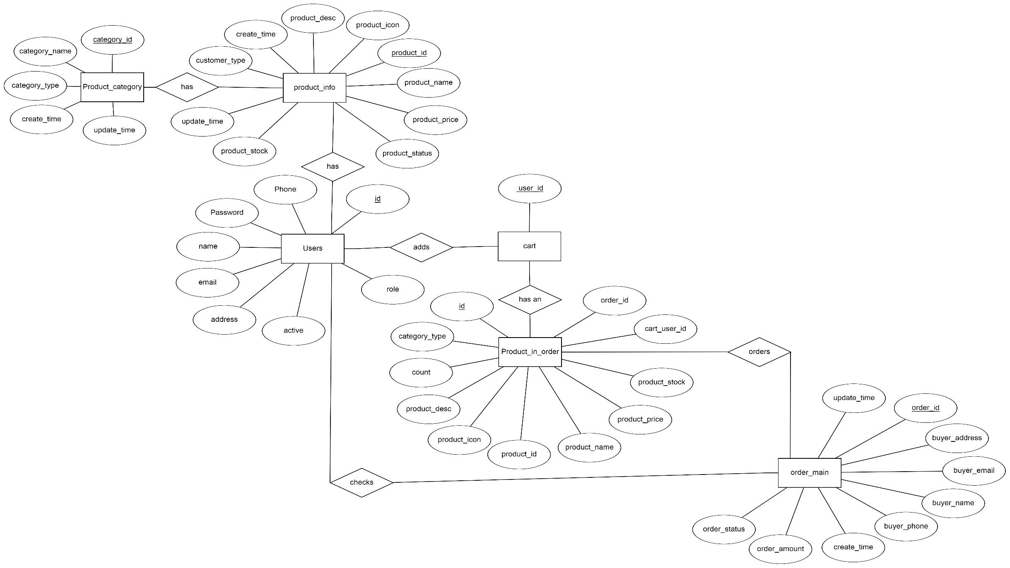
ER DIAGRAM

Slide 6
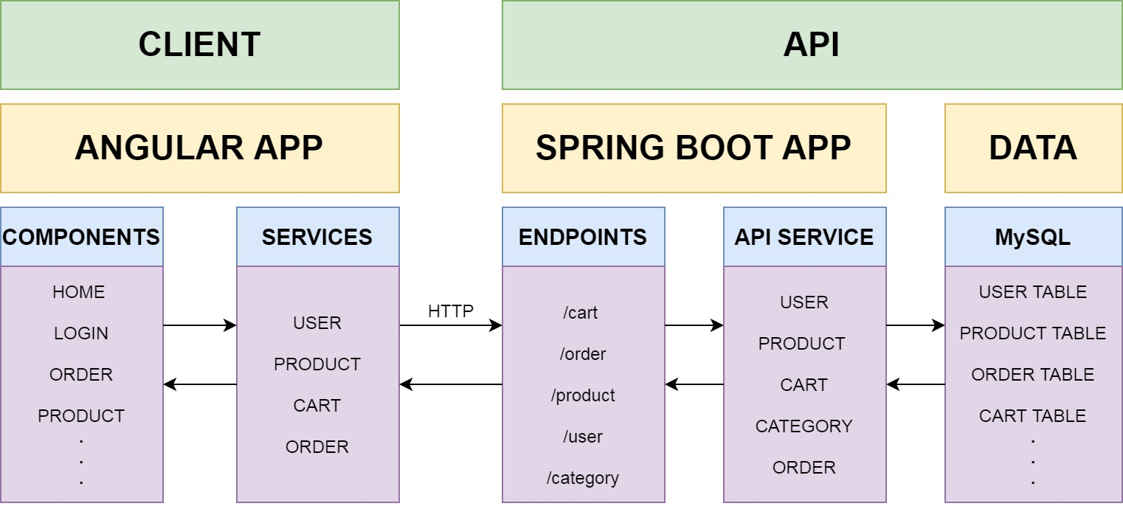
ARCHITECTURE

Slide 7

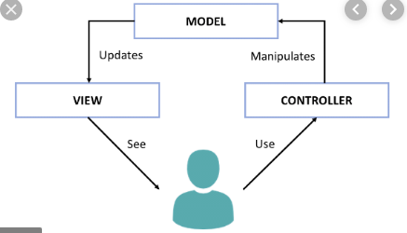

MVC STRUCTURE

Slide 8








FUNCTIONALITY
Checkout products
Browse through products
Add items to the cart
UPDATE STOCK
LogiN
LOGOUT
Delete items
Notes:
© Copyright PresentationGO.com – The free PowerPoint template library

Slide 9









TECHNOLOGIES USED
FRONTEND
DATABASE
BACKEND
Notes:
© Copyright PresentationGO.com – The free PowerPoint and Google Slides template library

Slide 10
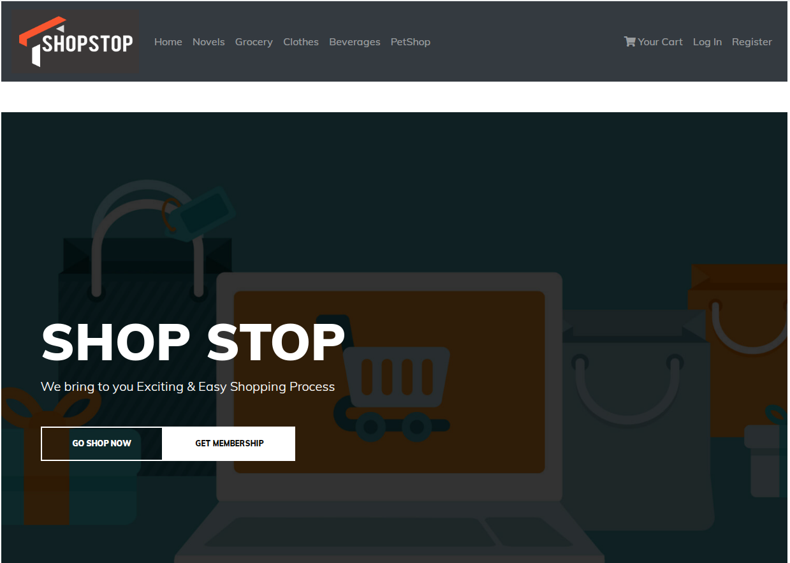

Slide 11
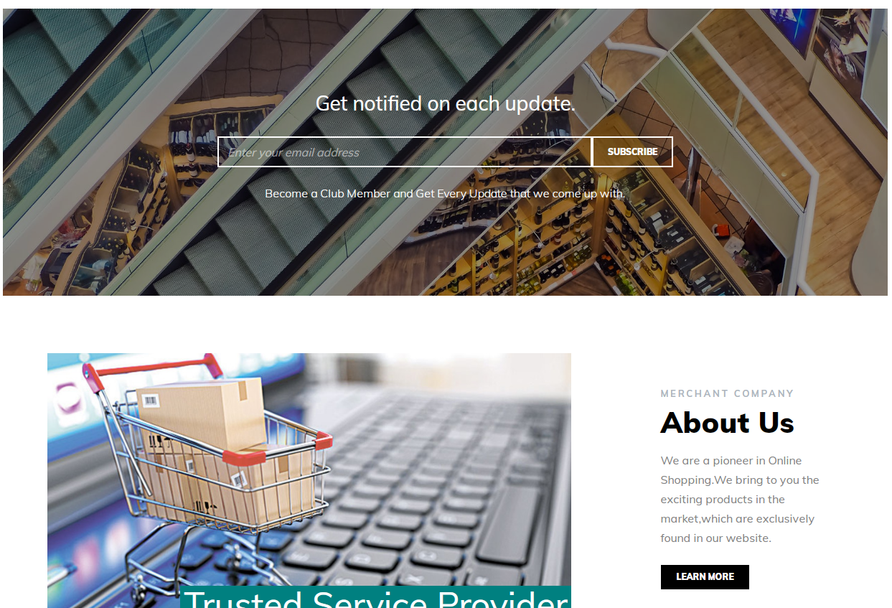

Slide 12
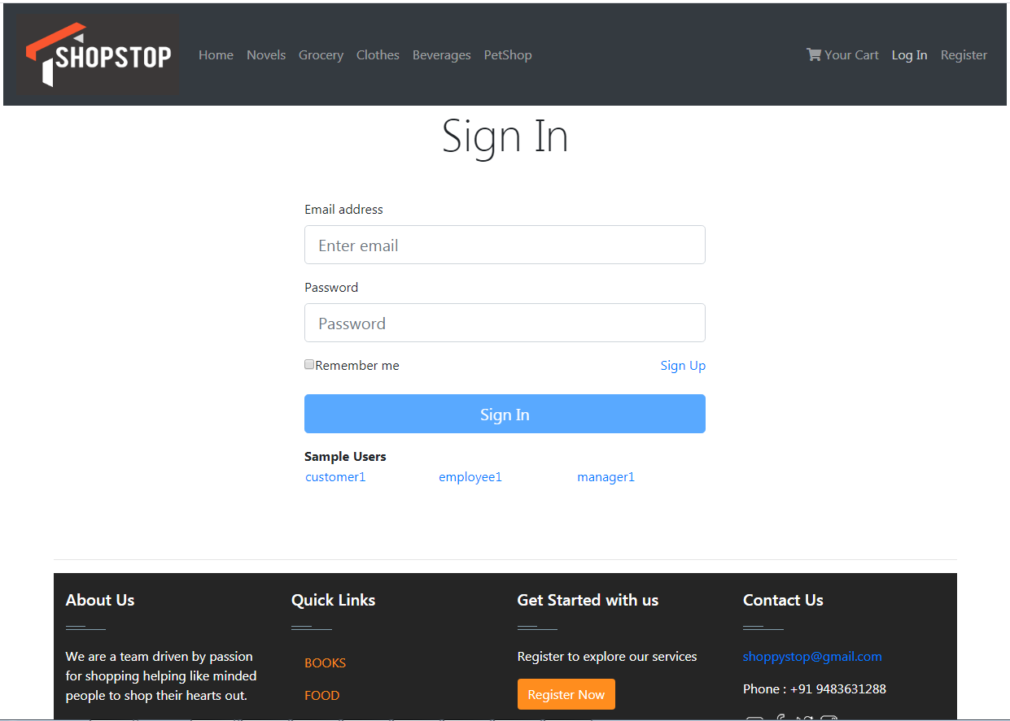

Slide 13
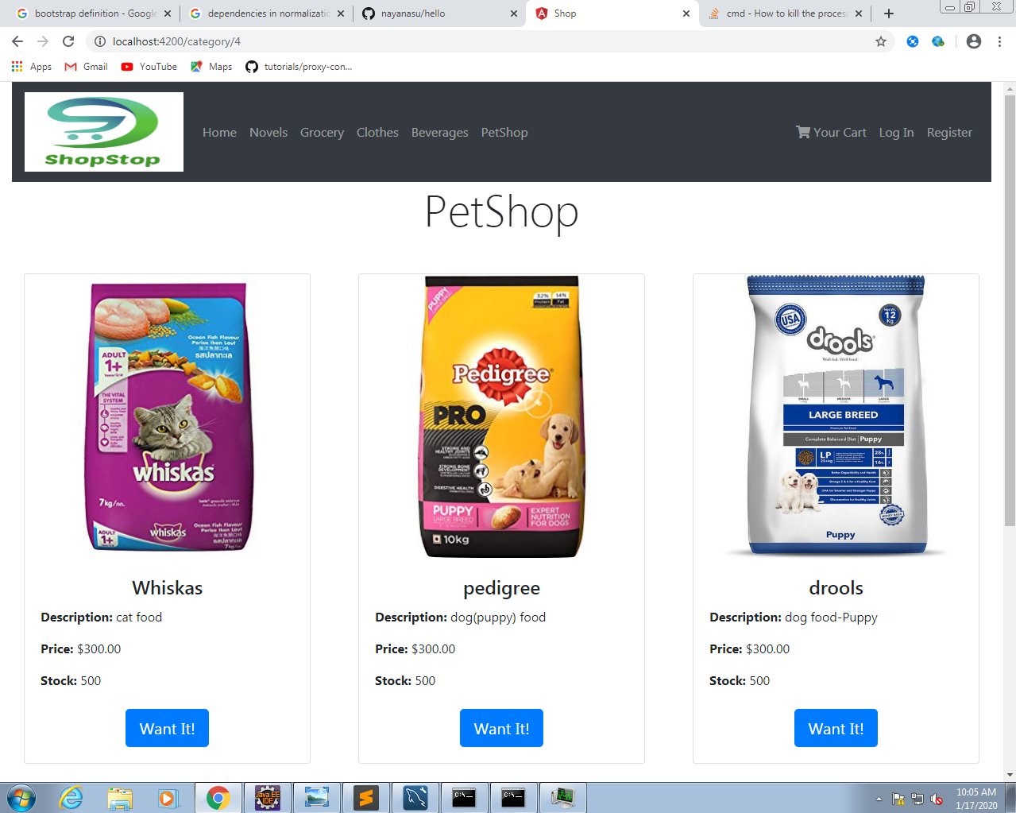

Slide 14
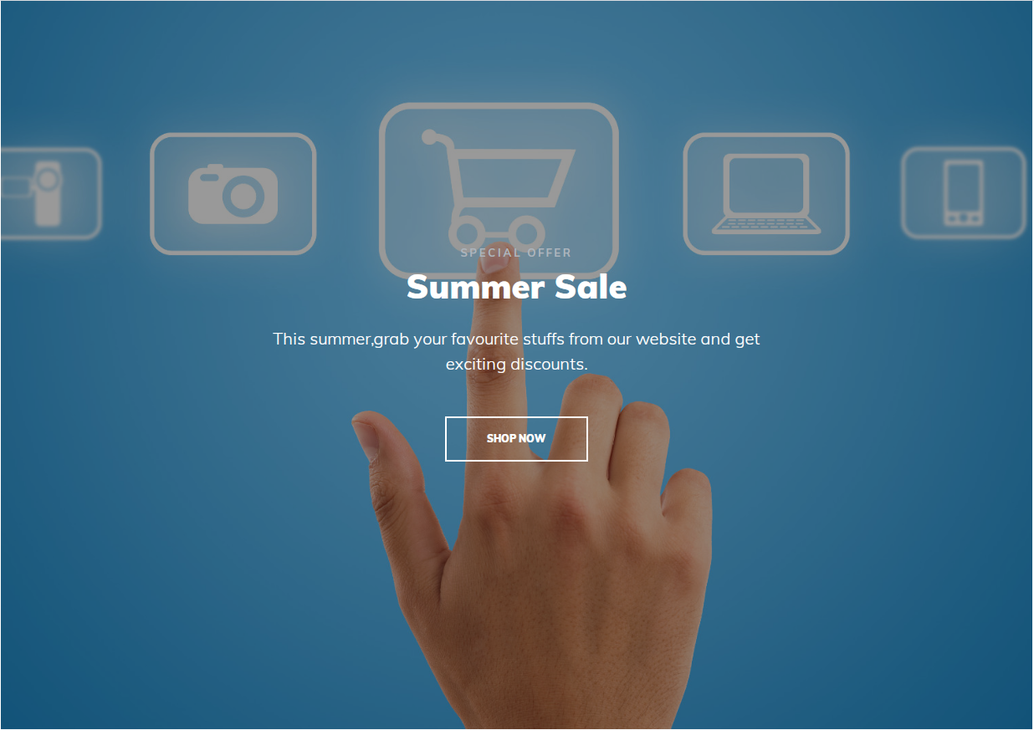

Slide 15
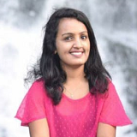
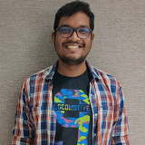
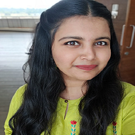
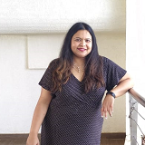
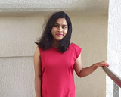
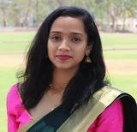
THE TEAM
ASHWITHA
UPASANA (TRAINER)
RAKSHIT
Jane Doe
Jane Doe
Jane Doe
SAHANA
RAHUL
SUPRITA
Jane Doe
Jane Doe
Jane Doe

Slide 16

CONCLUSION
Today's businesses must always strive to create the next best thing that consumers will want because consumers continue to desire their products, service, etc to continuously be better , faster and cheaper .
In the world of new technology , businesses need to accommodate to the new types of consumer needs and trends because it will prove to be vital to their business success and survival .
E-commerce is continuously progressing and is becoming more and more important to businesses as technology continues to advance and is something that should be taken advantage of and implemented.
Notes:
Photos by creativeart / Freepik

Slide 17

THANK YOU
Notes:
Photos by Freepik

